Slide 1
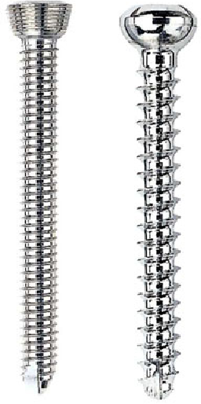
Daily Review
Which screw will require less input force to use? Explain your choice. (Assume the screws are the same size.)
Comparing Screws (and Bolts)
closer thread = smaller pitch = less input force required
The screw on the left will require less input force because its thread is closer or because its pitch is smaller, so the force acts over a larger distance.

Slide 2
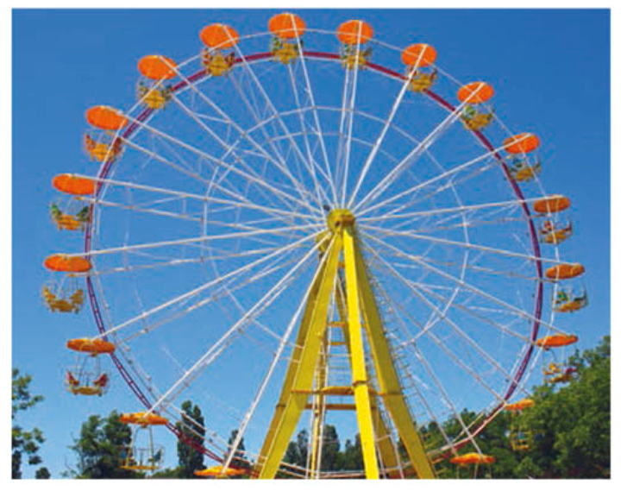
Daily Review
Label the input force and output force on the Ferris wheel.
Is the Ferris wheel a force or distance multiplier? Explain your choice.
The Ferris wheel is a distance multiplier because a small movement with a large input force creates a large movement with a small output force.
Reminder
Force multipliers: large movement → small movement small input force → large output force Distance multipliers: small movement → large movement large input force → small output force

Slide 3
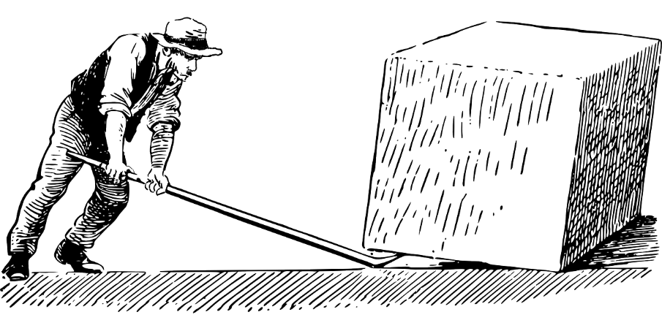
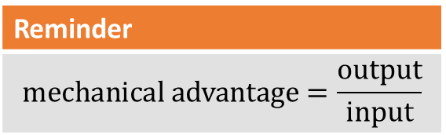
Daily Review
Reminder
$$\text{mechanical} \text{advantage}=\frac{\text{output}}{\text{input}}$$
A man is using a lever with a mechanical advantage of 8 and can provide 125 N of input force. What is the most weight he can lift?
Notes:
Answer: 800 N. I expect that the vast majority of students will require at least some guidance with this one.

Slide 4
Simple Machines: Pulleys Year 7 Science

Slide 5
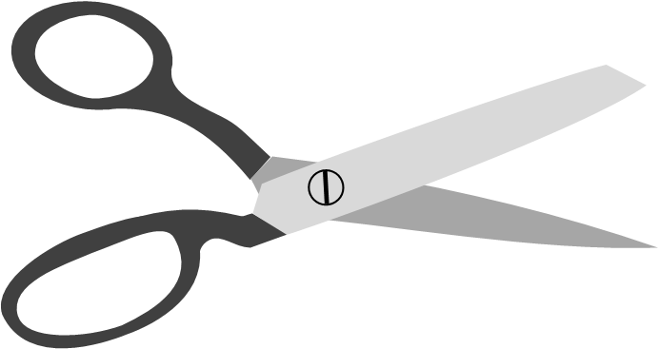
Learning Objectives
CFU
What are we going to learn?
Define and describe pulleys.
Determine the mechanical advantage of pulley systems.
Activate Prior Knowledge
Simple machines are being used all around us, every day.
Think, Pair, Share: Why do we use simple machines?

Slide 6
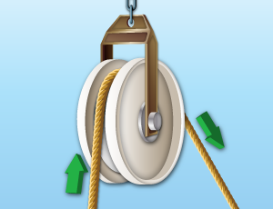
Concept Development
CFU 1
What is a pulley?
Pulleys
A pulley is a wheel with a groove along its edge.
By placing a rope in the groove, a pulley can change the direction of a force.
CFU 2
What can a pulley do to a force?
CFU 3
Could you use a scooter wheel as a pulley? Why or why not?

Slide 7
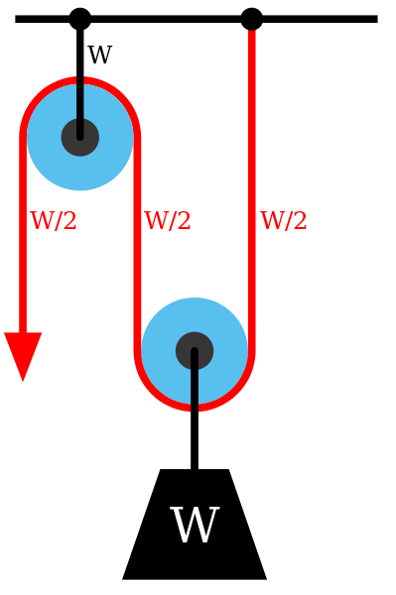
Concept Development
CFU 1
What mechanical advantage does a single pulley provide?
Mechanical Advantage of Pulleys
On its own, a pulley does not provide any mechanical advantage.
To have a mechanical advantage, two or more pulleys are required.
When two or more pulleys are joined together, a pulley system (also known as a block and tackle) is created.
CFU 2
How many pulleys do you need to obtain a mechanical advantage?
CFU 3
What is another name for a pulley system?

Slide 8
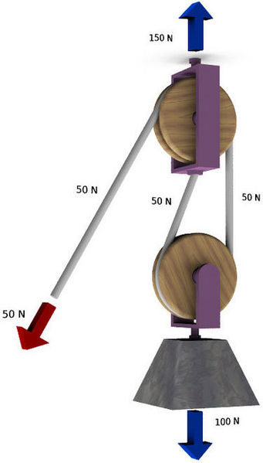
Concept Development
CFU 1
How do you determine the mechanical advantage of a pulley system?
Mechanical Advantage of Pulleys
In simple pulley systems, the mechanical advantage is equal to the number of pulleys in the system.
However, the distance you have to pull the rope is also multiplied by the number of pulleys.
CFU 2
If you had a two-pulley system, you would have to pull: twice as hard half as hard
CFU 3
If you had a two-pulley system, you would have to pull the rope: twice as far half as far

Slide 9
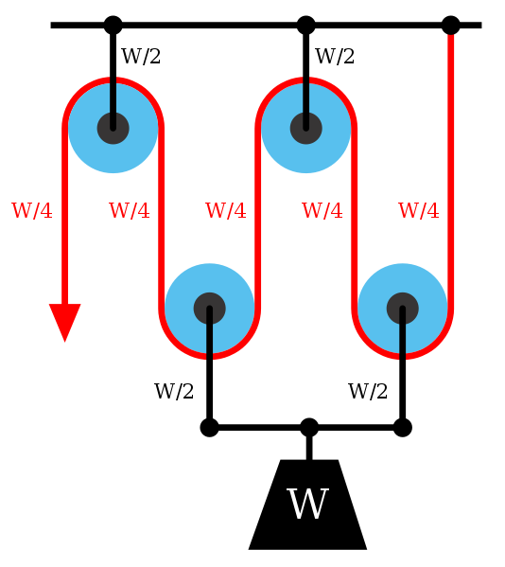
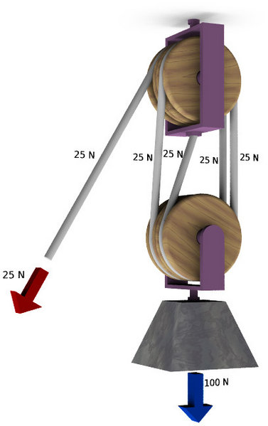
Skill Development / Guided Practice
CFU 1
How far would you have to pull the rope to lift the weight 2 m?
What is the mechanical advantage of this pulley system?
How do you know?
Reminder
Mechanical advantage = number of pulleys Distance pulled on the rope is multiplied by the number of pulleys.

Slide 10
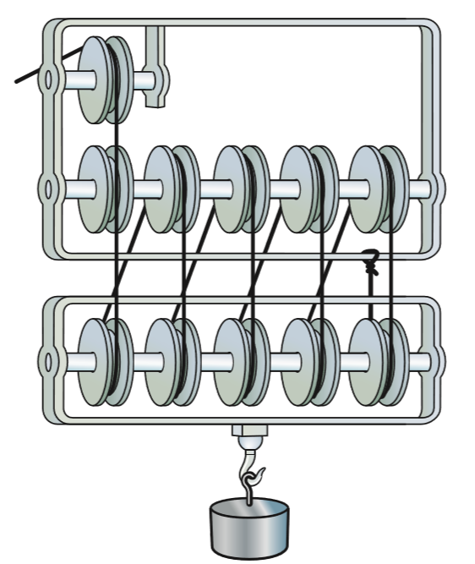
Skill Development / Guided Practice
CFU 1
How many pulleys are being used by the system?
What is the mechanical advantage of this pulley system?
CFU 2
How much easier will it be to lift the load?
The mechanical advantage of this pulley system is 11.
It will be 11 times easier to lift the load; one-eleventh of the original input force will be required.
The rope will have to be pulled 11 times further.
CFU 3
How much further will the rope travel to lift the load?

Slide 11
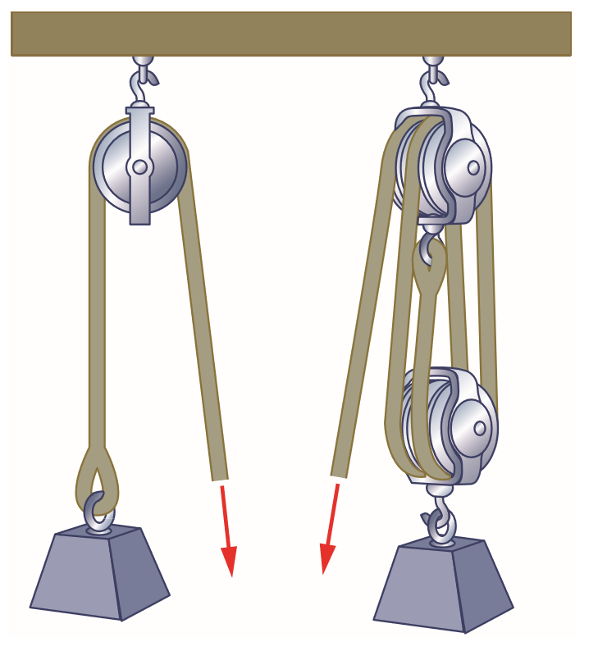
Skill Development / Guided Practice
CFU 1
How many pulleys are being used by each system?
Which pulley system will require less input force to lift a load? Explain your choice.
CFU 2
What is the mechanical advantage of each pulley system?
The pulley system on the right will require less input force to lift the load because it provides a mechanical advantage of 4.
The pulley on the left does not provide a mechanical advantage.
CFU 3
How much easier will it be to lift the load?
CFU 4
How much further will the rope have to be pulled to lift the load?

Slide 12
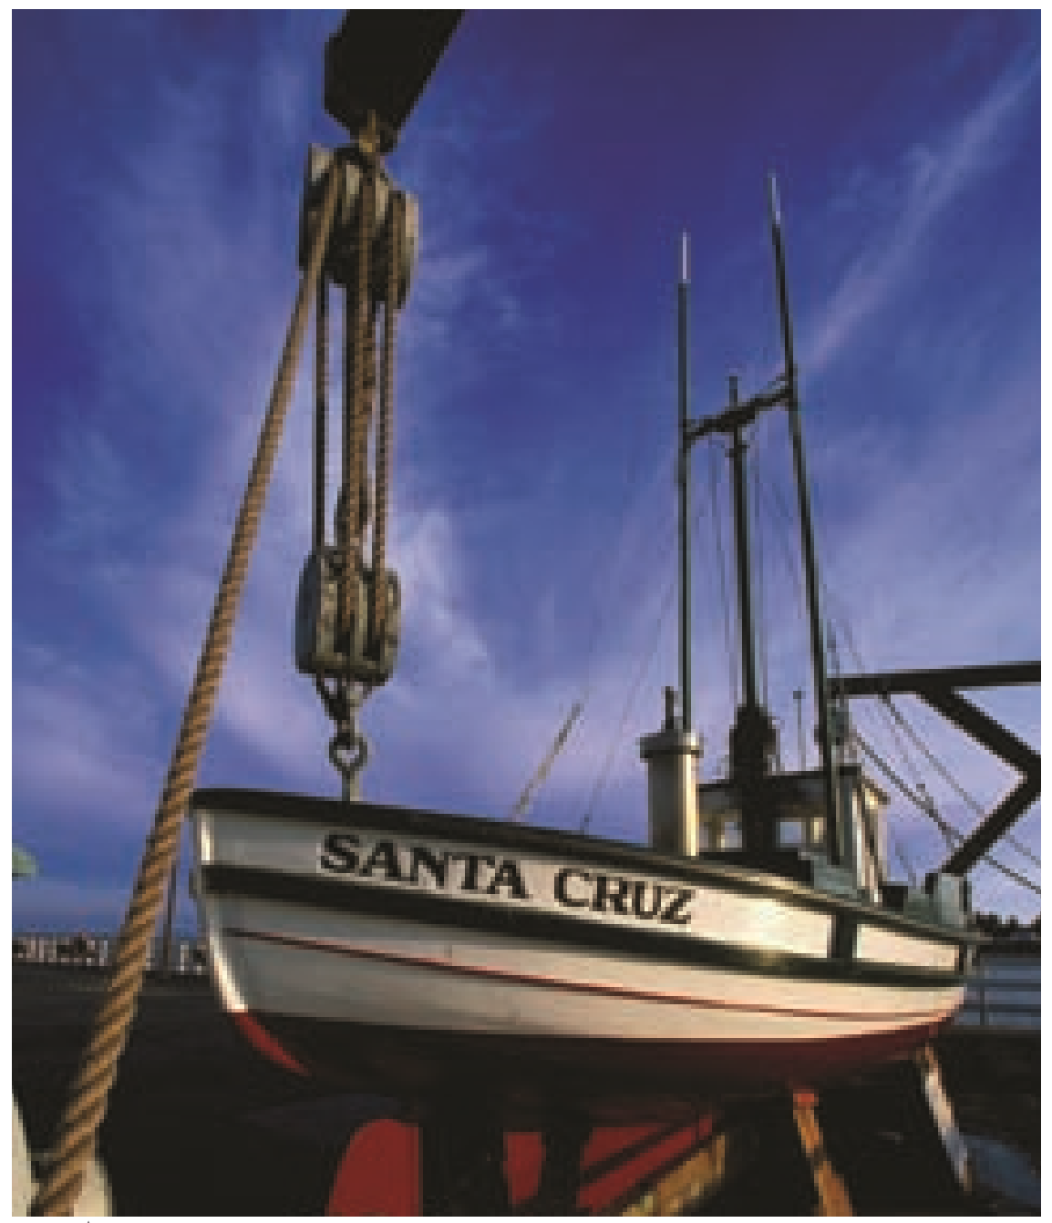
Relevance
Like the other simple machines, pulleys make our lives much easier.
Pulley systems (block and tackle mechanisms) are used to load and unload cargo carried by ships, trucks and other vehicles.
Blinds, cranes, flagpoles, elevators, engines, and many other inventions rely on pulleys to work.

Slide 13
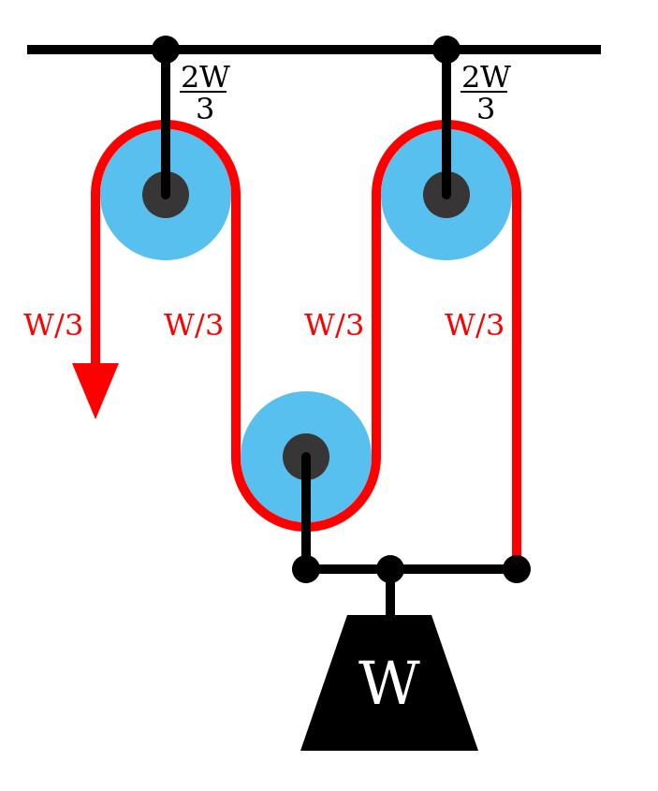
Skill Closure
1. What do you need to make a pulley?
2. Can a pulley change the direction of a force?
3. Can a single pulley provide a mechanical advantage?
4. What is the mechanical advantage of this pulley system? How do you know?
5. Name one invention which uses pulleys.

Slide 14
Independent Practice
Answer questions 1-6 on page 135 of your textbook. Write your answers as full sentences in your books or on your devices.

